Slide 1
Components of the Web Architecture
Waqar Yar.

Slide 2
AGENDA
Basic Web Architecture
HTML
URI
HTTP
Server Side \ Client Side Processing
AJAX
Web Services
XML
JSON

Slide 3
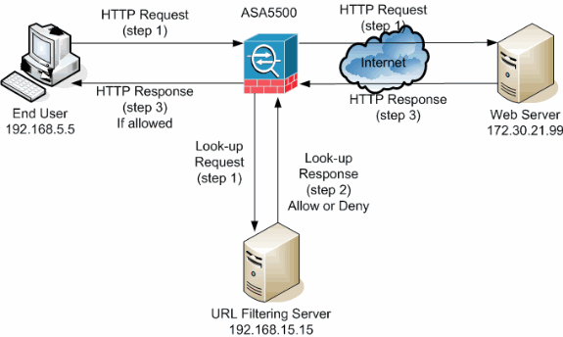
Basic Web Architecture
The Web is a two-tiered architecture
A web browser displays information content
A Web server transfers information to the client.

Slide 4
Web Browser
A web browser is a software application for retrieving, presenting and traversing information resources on the World Wide Web
The primary purpose of web browser is to bring information resources to the user.

Slide 5
Web Server
The term web server means:
A computer program that accepts HTTP requests and returns HTTP responses with optional data content.

Slide 6
The World Wide Web
In 1989, Tim Bernes-Lee had suggested to let all users particularly scientists browse each others papers on the internet.
He developed HTML,
URL and HTTP.

Slide 7
HTML
A Document Layout Language.
Defines the structure and appearance of a web page.
Many HTML documents are a result of manual authoring or word processing HTML converters.
HTML files are viewed using web browsers.

Slide 8
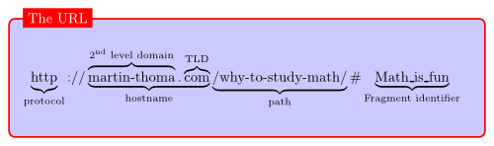
URL-Universal Resource Locator.
URLs are location dependant.
It contains four different parts:
The protocol type
The machine name
The directory path
The file name

Slide 9
HTTP-HyperText Transfer Protocol
HTTP is an application level protocol for distributed, collaborative, hypermedia information systems.
HTTP is a request response standard of a client and server.
Typically, an HTTP client initiates a request. Resources to be accessed buy HTTP are identified by URI.

Slide 10
Server Side \ Client Side Processing
Server Side:
PHP
J2EE
ASP
ASP.Net
Perl
Python
Ruby
Client Side:
CSS
HTML
Java Script
Adobe Flex
Microsoft Sliverlight

Slide 11
Ajax- Asynchronous JavaScript and XML
AJAX is not a technology. Its really several technologies each flouring in its own right.
Ajax incorporates:
XHTML and CSS
Document Object Model
XML and XSLT
XMLHttprequest
Javascript

Slide 12
Web Services
Web services is a software system designed to support machine to machine interaction over a network
Web services are Internet Application Programming Interfaces (API) that can be used over a network.

Slide 13
XML-eXtensibe Markup Language
XML is a universally agreed markup meta-language primarily used for information exchange
The two primary building blocks of XML are Elements and attributes
Elements are tags and have values
Elements are structured as a tree
Elements may have attributes and values.

Slide 14
XML
XML is a universally agreed markup meta-language primarily used for information exchange
The two primary building blocks of XML are Elements and attributes
Elements are tags and have values
Elements are structured as a tree
Elements may have attributes and values. <person gender="female"> <firstname>Anna</firstname> <lastname>Smith</lastname> </person>

Slide 15
XML-example
<person gender="female"> <firstname>Anna</firstname> <lastname>Smith</lastname> </person>

Slide 16
XML-example
<person gender="female"> <firstname>Anna</firstname> <lastname>Smith</lastname> </person>

Slide 17
JSON-JavaScript Object Notation
JSON is a light weight computer data interchange format.
JSON is based on a subset of JavaScript programing language.
It is considered tobe language independent data format.
It serves as an alternate to use of XML format.

Slide 18
JSON-example
{"employees":[
{"firstName":"John", "lastName":"Doe"},
{"firstName":"Anna", "lastName":"Smith"},
{"firstName":"Peter", lastName":"Jones"}
]}

